Slide 1

Process Discovery & Event Prediction using Deep Learning
A CNN-BASED APPROACH TO LOG ANALYSIS
SIDDHANT DANI
AUGUST 6, 2024

Slide 2
INTRODUCTION
Process Discovery:
Process discovery is a key aspect of process mining, focusing on identifying, mapping, and understanding business processes from event logs.
It helps organizations gain insights into their workflows, uncover inefficiencies, and ensure compliance.
Traditionally, process discovery relies on manual or semi-automated methods which can be time-consuming and error-prone.
Event Logs: Event logs are records of events or activities that occur within a process, captured in a structured format. They provide a detailed history of the execution of the process.
IMPORTANCE:
Accurate process discovery is crucial for:
Improving Efficiency: Identifying bottlenecks and streamlining operations.
Ensuring Compliance: Verifying that processes adhere to regulations and standards.
Enhancing Transparency: Providing a clear view of operations for stakeholders.

Slide 3
OBJECTIVES
To leverage deep learning techniques, specifically Convolutional Neural Networks (CNNs), for event prediction and log classification.
  Why CNNs?: CNNs are effective at identifying patterns in sequences, making them well-suited for analyzing event logs.
Improved Log Analysis: Develop a CNN-based model to automate the analysis of event logs, enhancing accuracy and efficiency.
  Automation Benefits: Automation reduces the need for manual analysis, saving time and reducing the potential for human error.
Trace Classification: Implement a method to classify and compare traces from test and base logs, determining which fits the process model better.
Enhance Predictive Capabilities: Utilize probability distributions of events derived from training data to predict future events accurately.

Slide 4
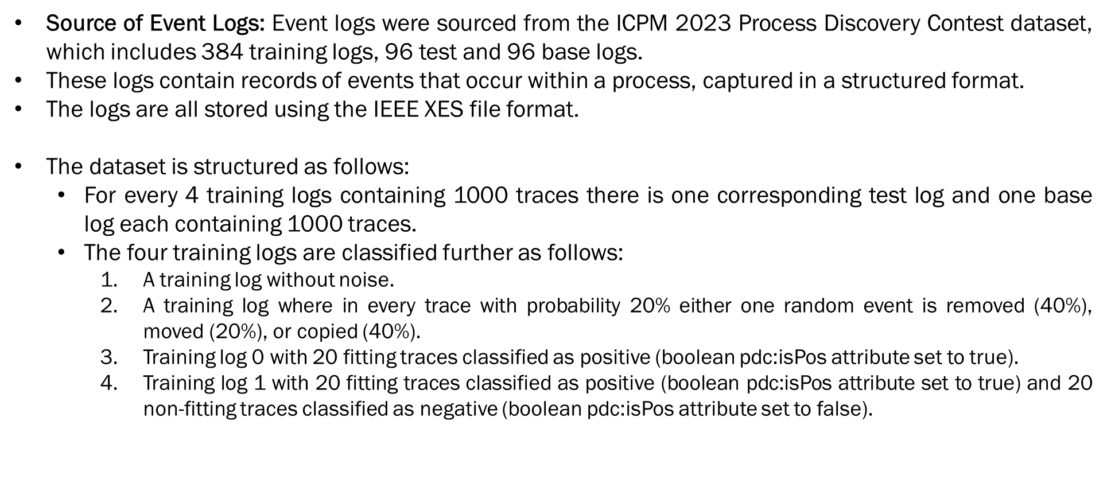
Dataset and Preprocessing

Slide 5
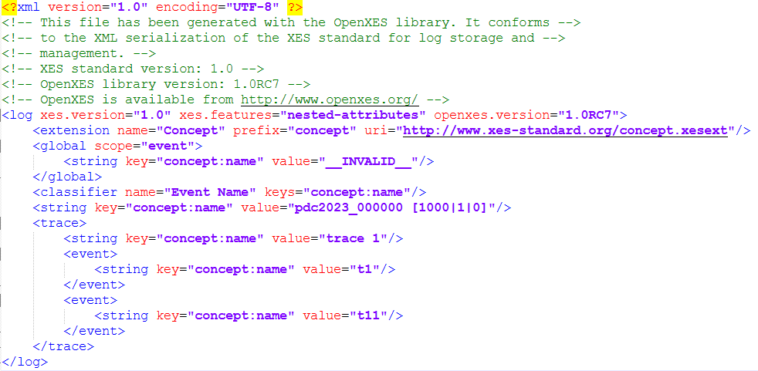
Structure of an Event log

Slide 6
Dataset and Preprocessing
Extracting Concept Names:
  Concept names refer to the specific activities or events recorded in the event logs.
  Extracting these names is crucial as they represent the core actions within the process, providing a sequence of activities that need to be analyzed.
  The extraction involves parsing the XML structure of the logs to retrieve the value of the 'concept:name' attribute from each event.
  This step converts the raw log data into a structured list of activities that can be further processed.
  An extracted sequence from the logs:
  [['t1', 't11', 't12', 't13', 't14', 't40', 't3', 't32', 't35', 't29', 't5', 't6', 't30', 't36', 't16', 't9', 't10', 't19', 't14', 't19', 't16', 't17', 't20', '<END>'], ['t1', 't2', 't3', 't32', 't29', 't30', 't11', 't3', 't6', 't7', 't9', 't12', 't13', 't14', 't19', 't16', 't17', 't10', 't20', '<END>'], ['t11', 't12', 't40', 't13', 't3', 't14', 't19', 't16', 't30', 't5', 't6', 't8', 't9', '<END>'],

Slide 7
Dataset and Preprocessing
Encoding Activity Names:
  Encoding activities is the process of converting textual activity names into numerical indices.
  This conversion facilitates the processing of sequential data by the neural network, allowing it to recognize patterns and learn from the sequences.
  Using a predefined mapping (dictionary) where each unique activity is assigned a specific numerical value, the extracted concept names are replaced with their corresponding indices.
  This step transforms the list of activities into a format suitable for input to the neural network.
  An extracted sequence after encoding:
  Encoded trace: [1, 3, 4, 5, 6, 23, 15, 17, 20, 14, 24, 25, 16, 21, 8, 28, 2, 11, 6, 11, 8, 9, 13, 0]
  Encoded trace: [1, 12, 15, 17, 14, 16, 3, 15, 25, 26, 28, 4, 5, 6, 11, 8, 9, 2, 13, 0]

Slide 8
Dataset and Preprocessing
Padding sequences:
  Padding sequences involves adjusting the length of encoded activity sequences to a uniform length.
  This is done by adding a special padding value (zeros) to shorter sequences so that all input sequences have the same length.
  Sequences are padded to a fixed length, which is determined based on the maximum expected sequence length.
  Shorter sequences are extended with padding values, while longer sequences are truncated if necessary.
  This step ensures that all sequences conform to the same input shape required by the neural network.
  An extracted sequence after encoding and padding:
  Encoded trace: [1, 3, 4, 5, 6, 23, 15, 17, 20, 14, 24, 25, 16, 21, 8, 28, 2, 11, 6, 11, 8, 9, 13, 0]
  Padded trace: [[ 1 3 4 5 6 23 15 17 20 14 24 25 16 21 8 28 2 11 6 11 8 9 13 0 0 0 0 0 0 0 0 0]]
  Encoded trace: [1, 12, 15, 17, 14, 16, 3, 15, 25, 26, 28, 4, 5, 6, 11, 8, 9, 2, 13, 0]
  Padded trace: [[ 1 12 15 17 14 16 3 15 25 26 28 4 5 6 11 8 9 2 13 0 0 0 0 0 0 0 0 0 0 0 0 0]]

Slide 9
Training Process and Model
A Convolutional Neural Network was chosen for its ability to capture patterns and dependencies in sequential data. CNNs are particularly effective at identifying local patterns and can be trained to recognize complex structures within the sequences.
Proposed Model Architecture is as follows:
  Embedding Layer: Converts each event's numerical index into a dense vector of fixed size (128).
  Convolutional Layer: Applies 64 convolutional filters to detect patterns and relationships within the sequence of events. The kernel size of 3 helps in capturing these patterns effectively.
  MaxPooling1D Layer: Reduces the dimensionality of the feature map by taking the maximum value over a pool size of 2. This helps in highlighting the most important features.
  Flatten Layer: Converts the 2D matrix of features into a 1D vector, preparing it for the fully connected Dense layers.
  Dense Layer(128 units, ReLU activation): Introduces non-linearity and learns complex relationships between features.
  Dropout Layer (0.5): Prevents overfitting by randomly setting half of the input units to zero during training.
  Dense Layer (Softmax activation): Outputs a probability distribution over the possible events, enabling classification.

Slide 10
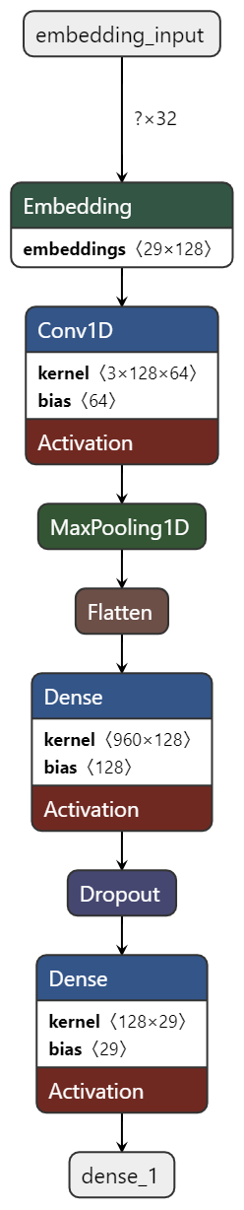

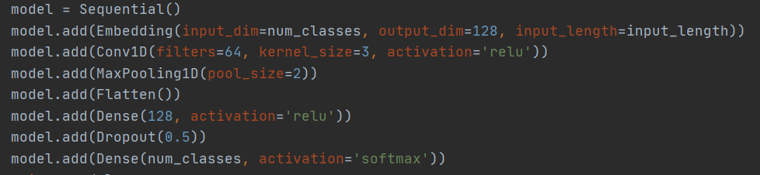
Training Process and Model
Proposed Model Architecture:

Slide 11
Training Process and Model
The training process involved feeding the preprocessed event sequences into the CNN model.
Sequence Generator: To efficiently handle the large dataset, a sequence generator was used. This generator yields batches of data, allowing the model to train on smaller subsets of the data at a time, which is particularly useful for large datasets.
Batch Sizes: Training was performed using a specific batch size to balance between memory constraints and convergence speed. The batch size used is 32.
Probability Distributions: The model learned to generate probability distributions for each event in the sequence, capturing the likelihood of various activities occurring.
The probabilities were exported as NumPy arrays and were store using .npy files.
Probability Array (e.g.):
[[0.00000000e+00 0.00000000e+00 3.16479400e-13 9.47278873e-15 6.08218645e-32 8.47715129e-21 0.00000000e+00 0.00000000e+00 0.00000000e+00 2.21072659e-02 3.96468416e-35 0.00000000e+00 9.90787043e-31 6.00620326e-21 8.56935643e-14 0.00000000e+00 1.89058230e-16 1.36284840e-37 6.87370753e-28 3.08194622e-34 9.33909154e-24 0.00000000e+00 1.97936257e-25 1.39101430e-26 9.77892697e-01 1.00565393e-28 0.00000000e+00 8.47505805e-34 1.80800983e-15]]

Slide 12
Classification and Evaluation
The CNN model processes each event sequence and outputs a probability distribution for each event.
These probabilities represent the model's confidence in predicting the occurrence of each event in the sequence.
For each trace in the test log and the base log a probability distribution is generated by the model.
Feature preparation:
  Mean Probability: The average likelihood of events in the trace, providing a central tendency measure.
  Variance Probability: The variability of the event likelihoods, indicating the consistency of the predictions.
  Extracted probabilities: [[0.0000000e+00 0.0000000e+00 1.2476459e-18 9.7833794e-01 1.3711813e-25
  4.4715707e-04 1.8086299e-26 0.0000000e+00 3.8236479e-24 3.6527234e-04 3.6618241e-24 1.2842952e-37 7.2499255e-08 8.2201331e-30 3.6950221e-10 .8812575e-09 3.9482824e-13 6.1039344e-07 7.0035743e-04 2.8074732e-13 5.4062137e-24 3.3382481e-34 1.8127537e-18 1.0090901e-14 7.8614157e-06 6.5515491e-19 0.0000000e+00 2.2156342e-25 2.0140827e-02]]
  Padded sequences for prediction: [[ 1 12 15 4 24 25 5 14 16 26 10 2 5 4 5 4 5 4 5 10 5 6 7 8
  9 13 0 0 0 0 0 0]]

Slide 13
Classification and Evaluation
RandomForestClassifier:
We chose RandomForestClassifier for its robustness and ability to handle high-dimensional data.
The classifier is trained on the feature vectors created from both test and base logs.
Each feature vector is labeled, with the test log sequences labeled as positive (1) and the base log sequences labeled as negative (0).
The classifier learns to differentiate between the test and base logs based on the patterns in the aggregated probabilities.
Test features:
[[0.03448276 0.03177619]
[0.03448276 0.03314056]
[0.03448276 0.03173334] ...
[0.03448276 0.03329369]
[0.03448276 0.0328804 ]
[0.03448276 0.03329369]]
Base features:
[[0.03448275 0.03322482]
[0.03448276 0.03272688]
[0.03448275 0.03294198]...
[0.03448276 0.03278309]
[0.03448276 0.0252279 ]
[0.03448276 0.03329369]]

Slide 14
Classification and Evaluation
Decision Making:
After training, the classifier is used to predict the probability that a given sequence belongs to the test log rather than the base log.
For each sequence, the classifier outputs a similarity score between 0 and 1, indicating the likelihood that the sequence fits the model of the test log.
If the similarity score for a test trace is higher than for a corresponding base trace, it is considered a better fit for the model.
Trace 1: Test Similarity = 0.6200, Base Similarity = 0.4000
Trace 2: Test Similarity = 0.6043, Base Similarity = 0.3000
Trace 4: Test Similarity = 0.4323, Base Similarity = 0.4853
Trace 5: Test Similarity = 0.2695, Base Similarity = 0.3970
Trace 6: Test Similarity = 0.4853, Base Similarity = 0.4853

Slide 15
Classification and Evaluation
Metrics:
The model’s performance was evaluated using several key metrics such as Precision, Recall and F-score.
Overall Results:
Total Average F-score: 0.9183
Total Average Precision: 0.9275
Total Average Recall: 0.9251
The high values for Precision, Recall and F-score indicate that the trained models are performing well in differentiating test and base logs.

Slide 16
Challenges and Solutions
Time Consuming:
The entire process of training models, extracting probabilities, and performing classification was extremely time-consuming.
Because of the huge size of the training dataset, on average just training the models took about a week and then for classification another day.
After a lot of discussions and code changes, we were able to optimize the code to reduce the execution time. Currently, we can conclude the entire process in about 3 days.
We implemented a sequence generator function that generates and batches the sequences simultaneously, reducing the training time significantly.
CAIR Cluster: The Centre for Analytics, Informatics, and Research (CAIR) is a high-performance computing center with the capacity to rapidly process and analyze vast amounts of data and provide secure storage with off-site backups.
Contact: cair-support@mun.ca

Slide 17
Challenges and Solutions
Handling <END> of a sequence tokens:
The <END> tokens were crucial for denoting the end of sequences but posed challenges in sequence processing and prediction.
Initially we did not consider that at some point a sequence terminates and were processing the events as it is and ignored the end case tokens while training the models.
But this approach caused prediction issues as the models could not predict the end of a sequence and produced incorrect results.
After a few discussions, we were able to identify the issue and designed a code logic that handles and considers the <END> tokens for a sequence.
Because of this the models now are also able to predict the end-of-sequence probability of whether a sequence will terminate after some events or not.
This helped us in achieving a better overall prediction rate.

Slide 18
Challenges and Solutions
The Original Idea:
The initial idea was to predict the probability for each event in a sequence and then decide based on the multiplied probabilities, whether the trace fits the model better or not.
But with this approach we are facing an issue with training the classifier, as the multiplied probabilities sometimes are so small that they are close to zero.
Also, for the higher values the classifier performance is not great.
Hence, we shifted to an approach to predict the probabilities over the entire sequence for each sequence in base and test logs.
And now we are using the aggregated probabilities and features like mean and variance for classification.
This approach simplified the complexity of the prediction process and still maintained the performance.
It also brought down the time required for the prediction process from a day to 4 hours.

Slide 19
Conclusion
The project aimed to enhance the process of predicting and classifying event sequences from logs using advanced machine-learning techniques.
We developed a CNN-based model to extract probabilities for each event in a sequence, forming the foundation of our classification approach.
By using RandomForestClassifier, we developed a robust system to compare test logs against base logs, achieving high accuracy and reliable classification.
The model demonstrated excellent performance, achieving an average F-score of 0.9183, precision of 0.9275, and recall of 0.9251.
These metrics indicate a strong balance between precision and recall, ensuring both the identification of relevant events and the minimization of false positives.
The developed methodology is flexible enough to be adapted for various types of sequence data, making it applicable to a wide range of domains beyond the scope of this project.

Slide 20
Future Work
Exploring Other Deep Learning Models: Long Short-Term Memory (LSTM) and Gated Recurrent Unit (GRU) networks, which are well-suited for sequential data and may offer improved performance over CNNs in capturing long-range dependencies.
Feature Enrichment: Incorporate additional features and contextual information into the logs. This could involve metadata about events, user interactions, or environmental conditions, providing the model with more data to learn from.
Scalable Architecture: Ensure the solution can scale efficiently to handle larger datasets and more complex log structures. This might involve distributed computing techniques or optimizations in data processing and model inference.
Noise and Incomplete Data Handling: Enhance the model's robustness to noisy and incomplete data. This could involve techniques such as data augmentation, noise reduction algorithms, or robust loss functions.
Practical Applications: Integrate the developed solution into practical applications and systems for automated log analysis. Potential applications include anomaly detection, user behavior analysis, and process optimization.

Slide 21
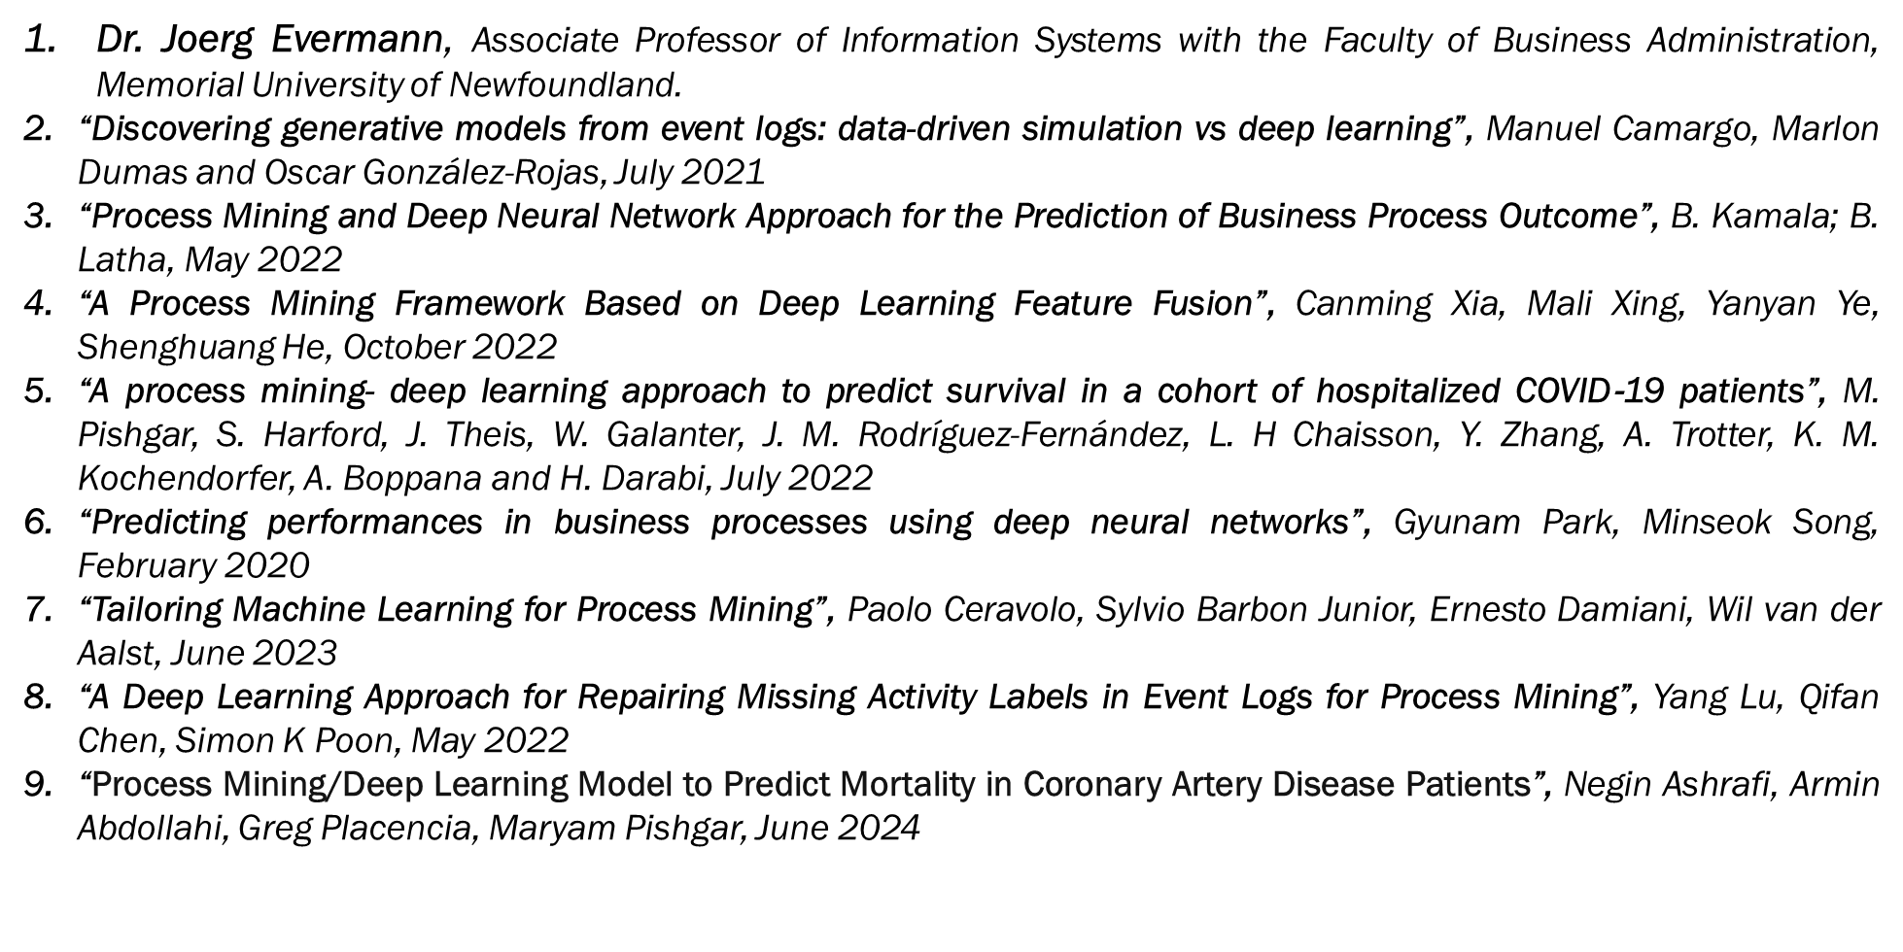
Acknowledgements

Slide 22
Thank You!!!

